Slide 1

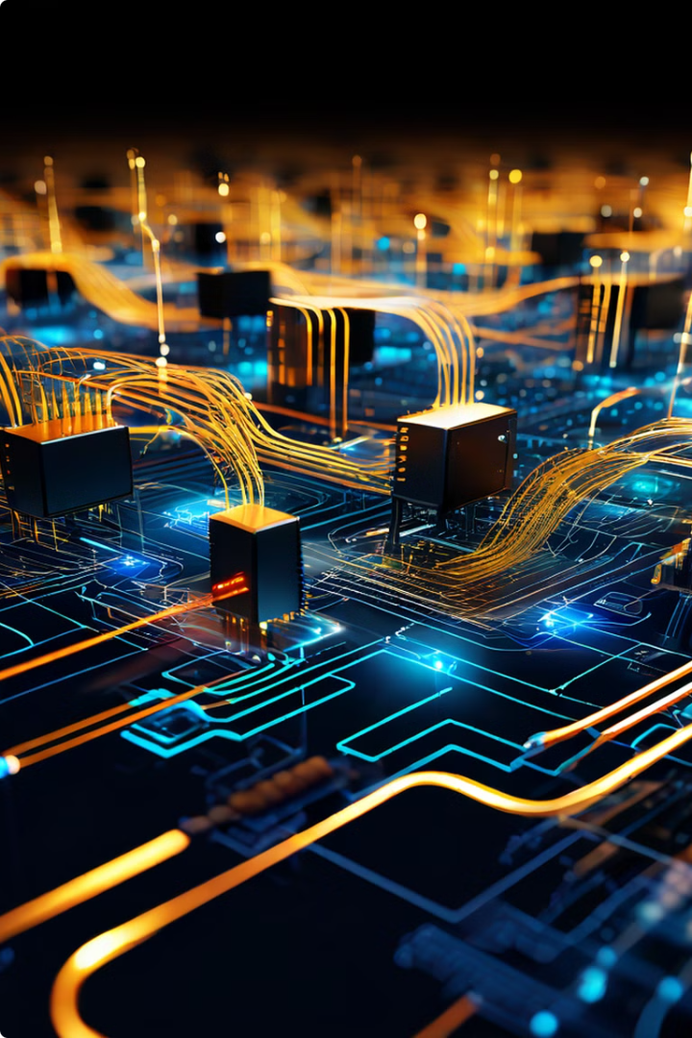
Introduction to TCP/IP
TCP/IP is a fundamental communication protocol suite that forms the backbone of the internet and many other networks. It defines how devices interact, enabling the seamless transmission of data across vast distances.
by James Makomele Ebitonyi

Slide 2
Transmission Control Protocol (TCP)
TCP provides a reliable and ordered delivery of data between applications. It segments data into packets, ensuring each packet reaches its destination in the correct order, with error detection and retransmission if necessary.
Key Features of TCP
TCP in Action
Reliable Delivery
When you browse the web, TCP ensures that the web pages you request are delivered completely and in the right order. It also handles any errors that might occur during transmission.
Ordered Delivery
Error Checking
Flow Control

Slide 3

Internet Protocol (IP)
IP is responsible for addressing and routing data packets across networks. It assigns unique IP addresses to devices and determines the best path for packets to travel, ensuring data reaches its intended destination.
1
IP Addressing
Each device on a network has a unique IP address, like a postal address for data packets.
2
Packet Routing
IP determines the most efficient route for packets to travel, navigating through complex networks.
3
Network Hierarchy
IP organizes networks into a hierarchical structure, enabling efficient addressing and routing at various scales.

Slide 4
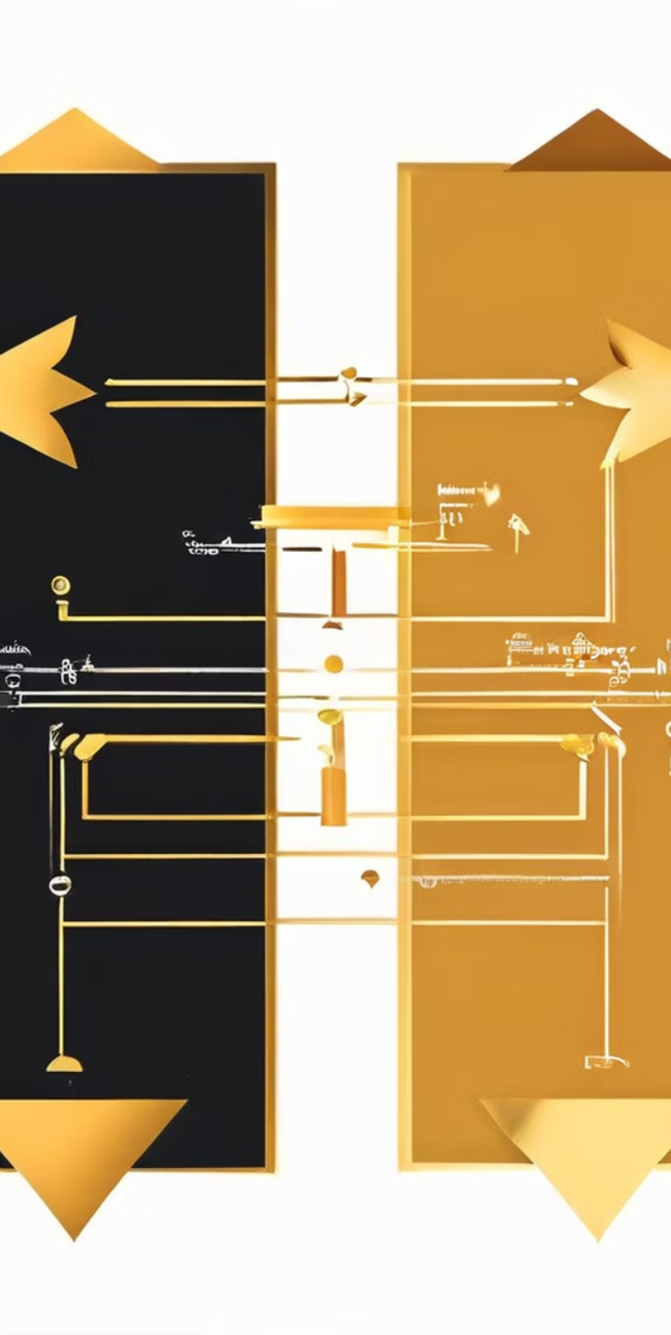
The OSI Model and TCP/IP
The OSI model and TCP/IP model are both frameworks for understanding network communication. While the OSI model is a theoretical reference model, TCP/IP is a practical implementation.
OSI Layer
TCP/IP Layer
Function
Application
Application
Provides services to users, such as email, web browsing, and file transfer.
Presentation
Application
Handles data formatting and encryption.
Session
Transport
Establishes and manages communication sessions between applications.
Transport
Transport
Provides reliable and ordered delivery of data, like TCP.
Network
Internet
Handles addressing and routing of data packets, like IP.
Data Link
Network Interface
Provides access to the physical network and manages data flow between devices.
Physical
Network Interface
Defines the physical characteristics of the network, such as cable types and signaling methods.

Slide 5





TCP/IP Layers and Functions
TCP/IP is a layered protocol suite, with each layer performing specific functions. This layered architecture allows for modularity and flexibility, making it adaptable to various networking scenarios.
Application Layer
Provides services to applications, such as email, web browsing, and file transfer.
Transport Layer
Handles reliable data delivery, segmenting data into packets, and providing error checking.
Internet Layer
Manages addressing and routing of data packets, ensuring they reach their intended destinations.
Network Interface Layer
Provides access to the physical network and manages data flow between devices.

Slide 6

TCP/IP Addressing and Routing
TCP/IP employs a hierarchical addressing system to uniquely identify devices on networks. IP addresses are used for routing data packets across networks, ensuring efficient and accurate delivery.
IP Addresses
Subnets
Routing Tables
Each device on a network has a unique IP address, like a postal address for data packets.
Networks are often divided into subnets, allowing for more efficient management and security.
Routers use routing tables to determine the best path for data packets to travel, based on destination IP addresses.

Slide 7
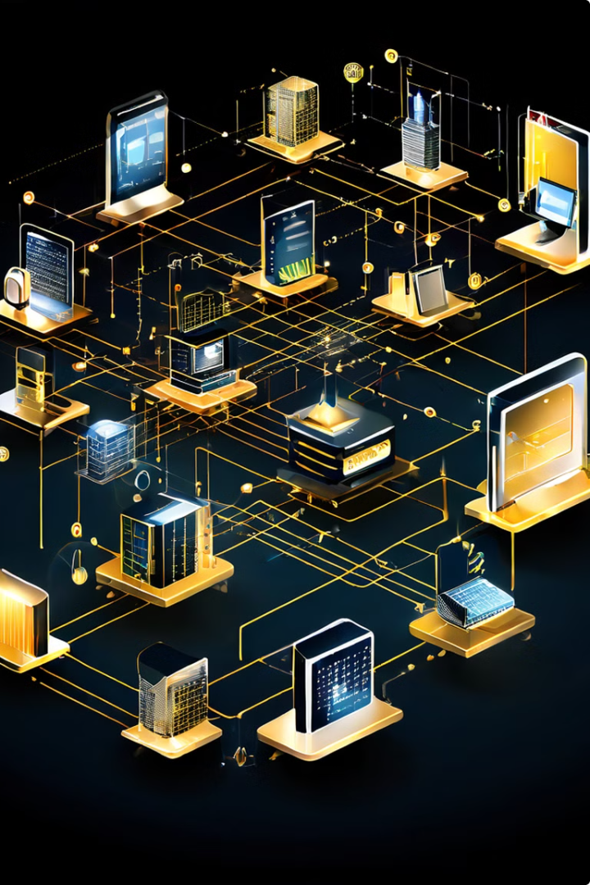



TCP/IP in Modern Networking
TCP/IP is ubiquitous in modern networking, supporting various technologies, including the internet, intranets, and wireless networks. It provides the foundation for seamless communication between devices, enabling the exchange of data and information.
Internet
TCP/IP is the foundation of the internet, enabling global communication and information sharing.
Mobile Networks
TCP/IP is essential for mobile networks, allowing devices to connect to the internet and communicate with each other.
Data Centers
TCP/IP plays a vital role in data centers, enabling efficient data storage, processing, and distribution.

Slide 8

Conclusion and Key Takeaways
TCP/IP is a fundamental and ubiquitous protocol suite that forms the backbone of modern networking. Its layered architecture, addressing system, and routing mechanisms enable reliable and efficient communication between devices across diverse networks.
1
Foundation of the Internet
TCP/IP is the cornerstone of the internet, enabling global connectivity and information sharing.
2
Reliable Data Delivery
TCP ensures data is delivered reliably, in the correct order, and with error detection.
3
Addressing and Routing
IP provides a unique address for each device and determines the best path for data packets to travel.
4
Ubiquitous in Modern Networking
TCP/IP is essential for various networks, including the internet, intranets, and wireless networks.

